Slide 1
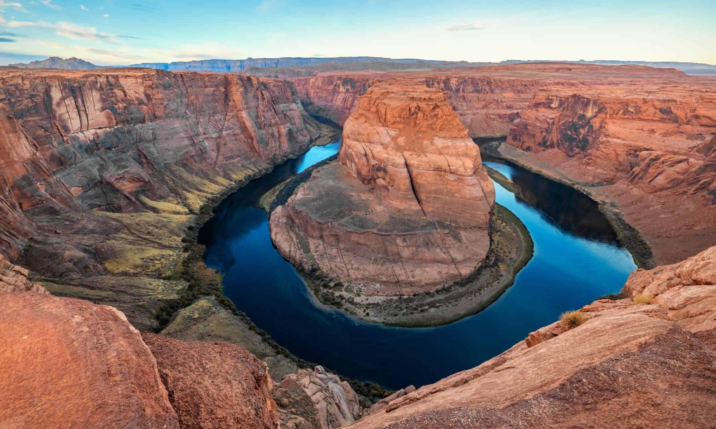
Unity in the Colorado River Basin
Rhett Larson
Arizona State University Sandra Day O’Connor College of Law
Richard Morrison Professor of Water Law
Senior Research Fellow, Kyl Center for Water Policy

Slide 3
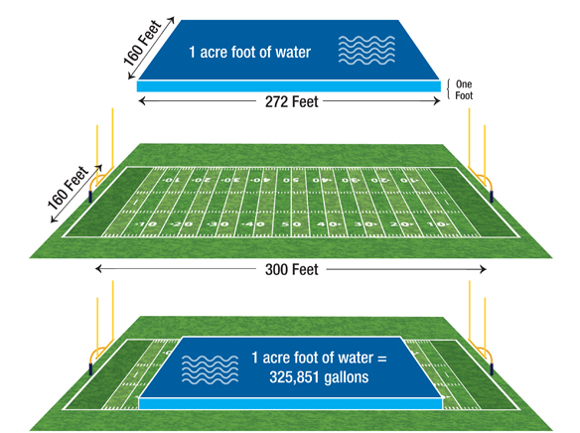
1 acre-foot = 1233.5 m³

Slide 4
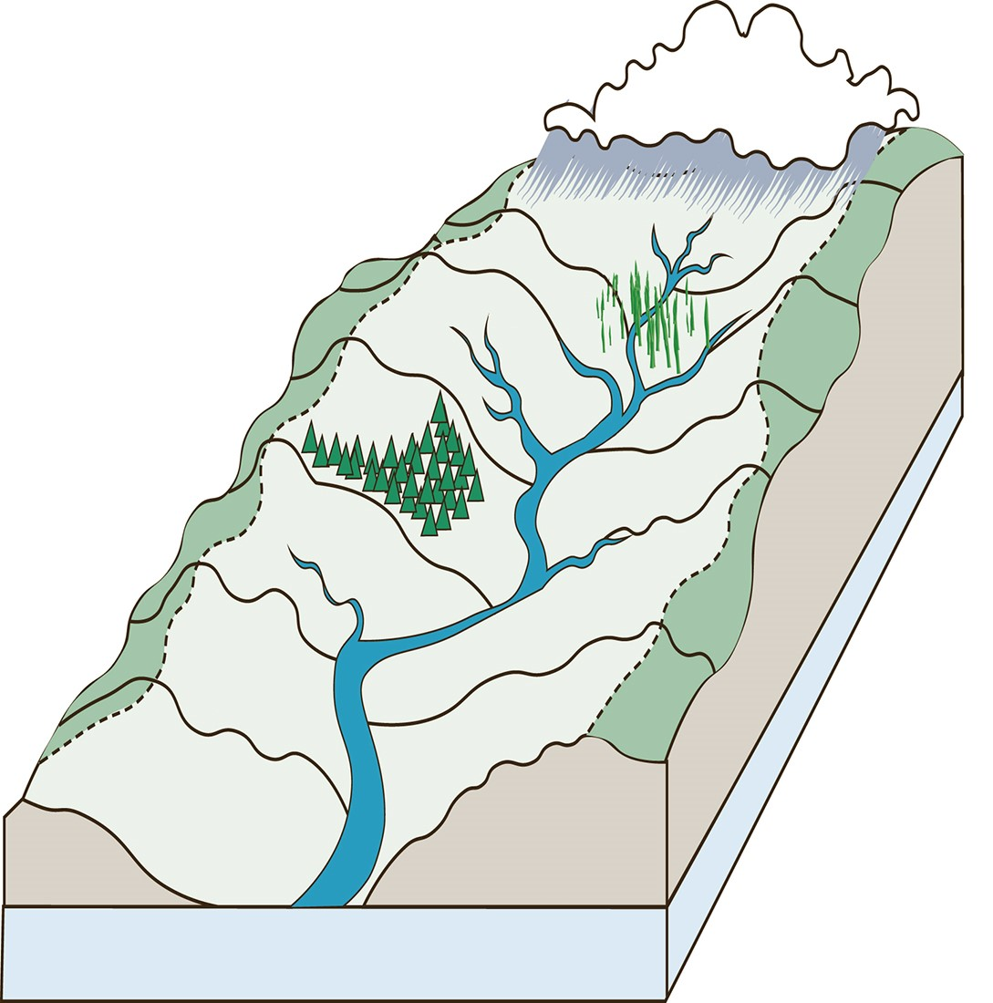
Governing Water
basin boundary
tributary
river
ground water

Slide 5
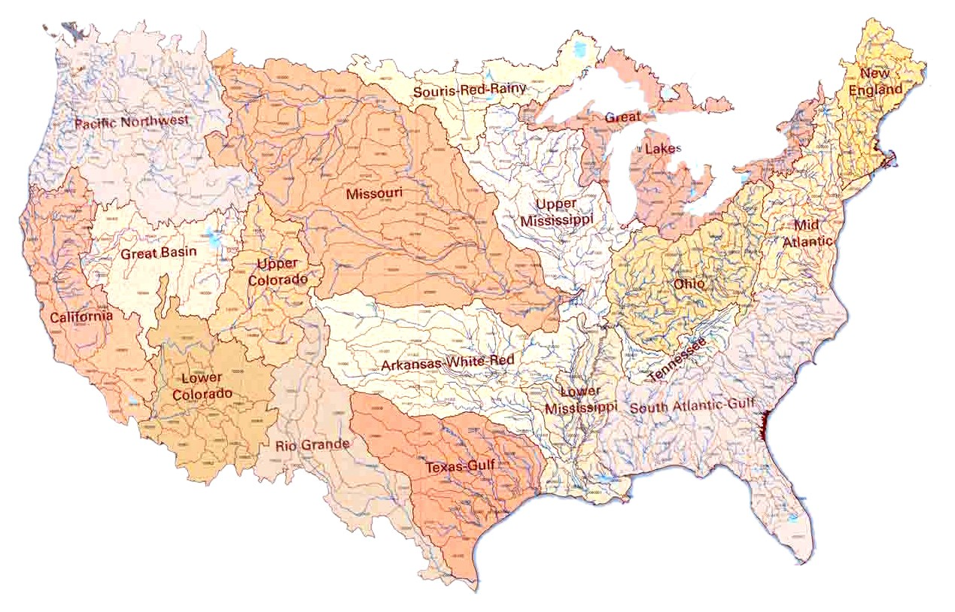

Slide 6
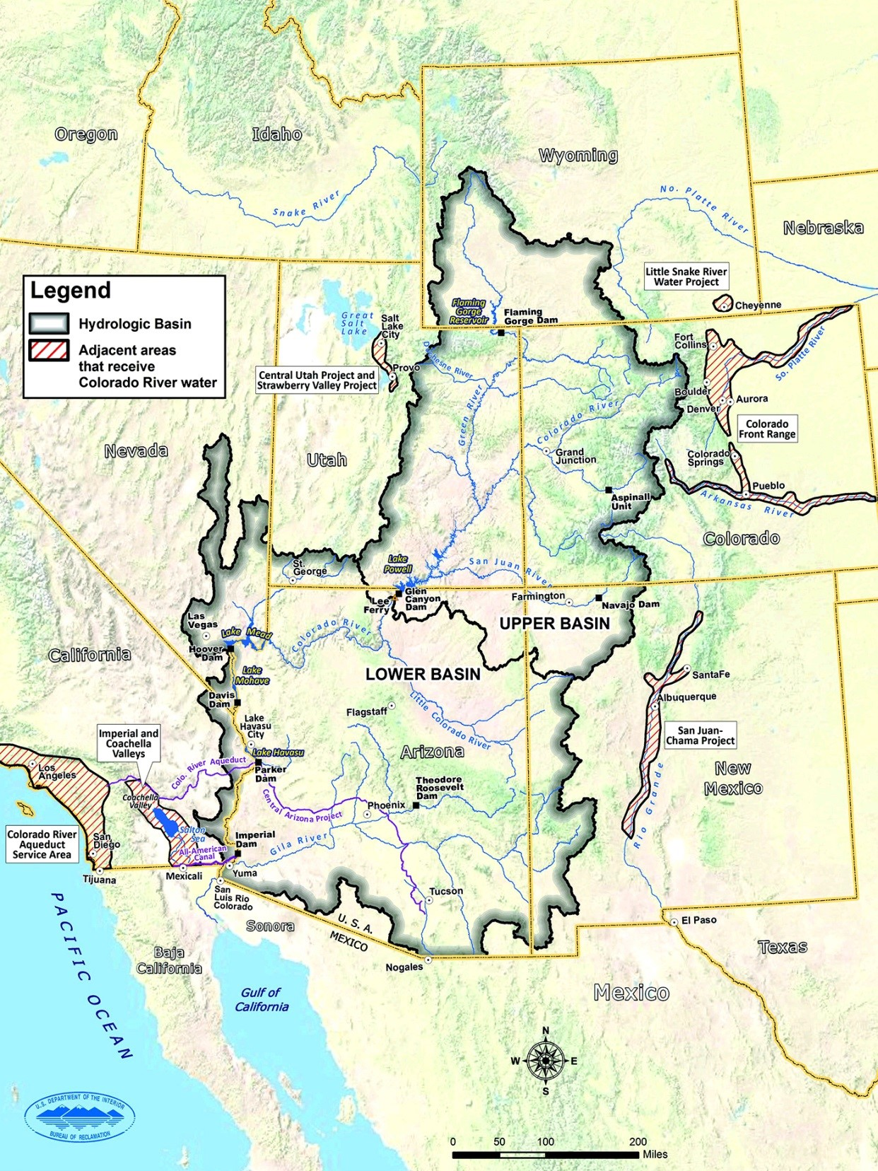
courtesy: u.s. bureau of reclamation

Slide 8
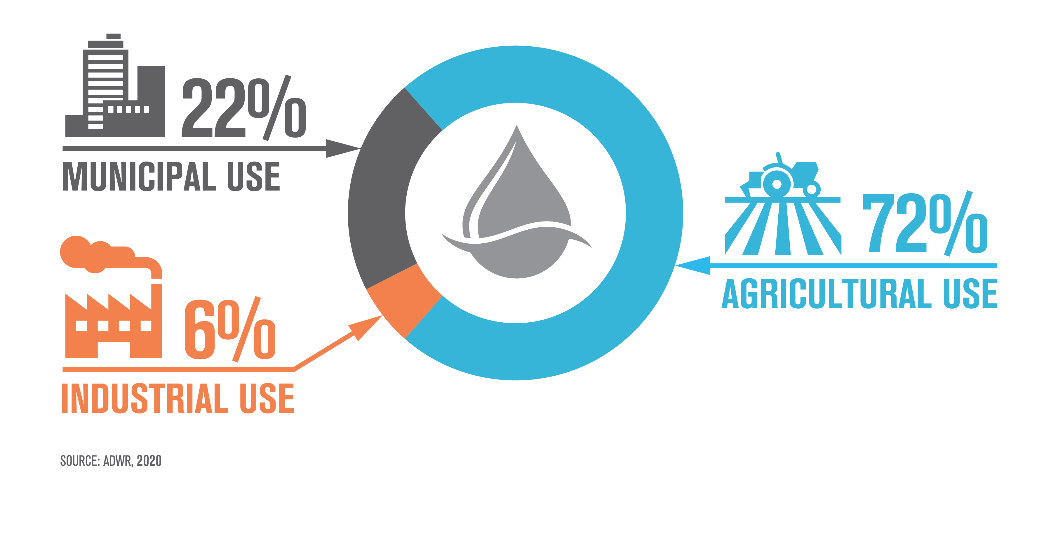

Slide 10
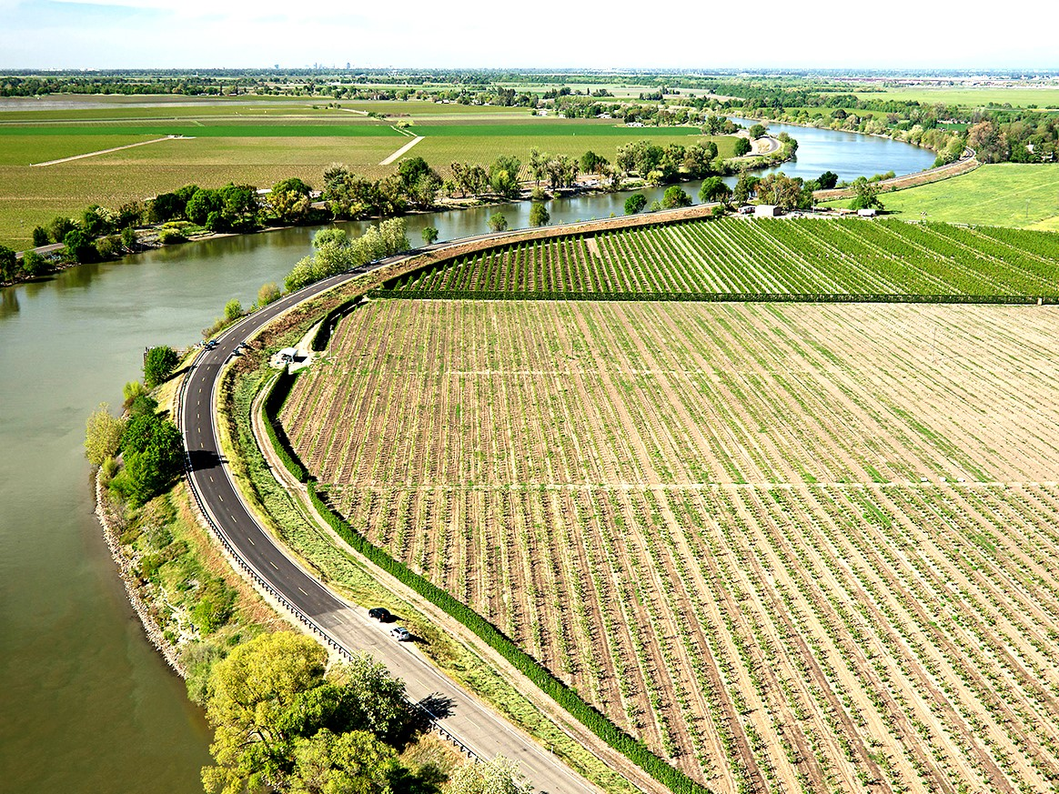

Slide 11
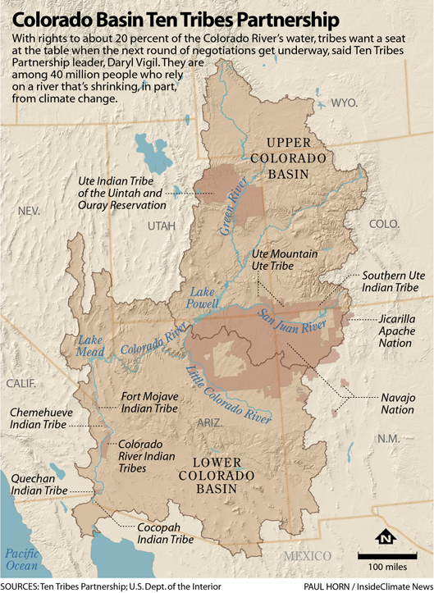
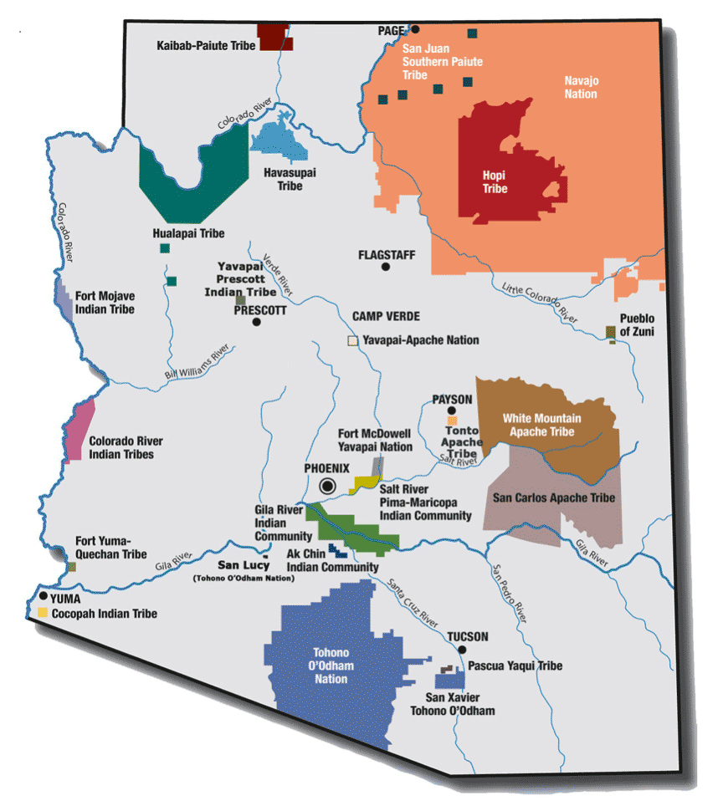
Native American Tribes in Colorado River Basin
Arizona v. California Decreed Rights:
Chemehuevi
Cocopah
Fort Yuma (Quechan)
Colorado River Indian Tribes
Fort Mohave Indian Tribes

Slide 12
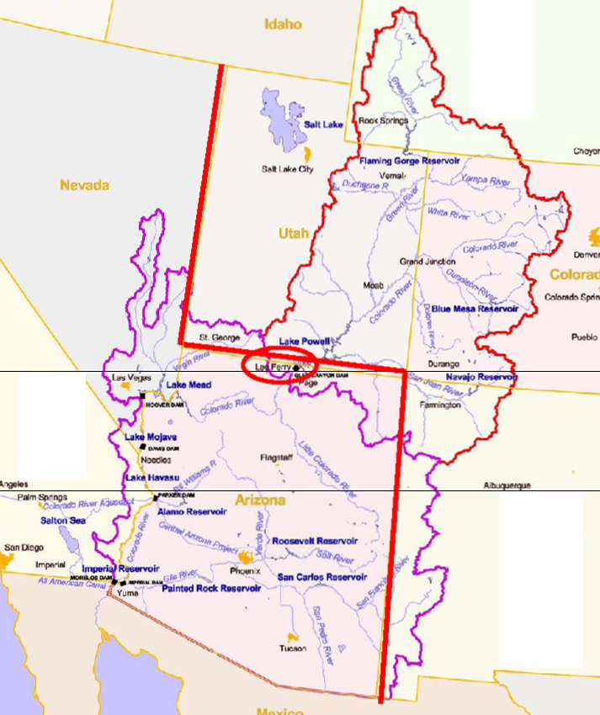
Colorado River Inter-State Allocation 7.5 maf to Upper; 7.5 maf to Lower; 1.5 maf to Mexico

Slide 13
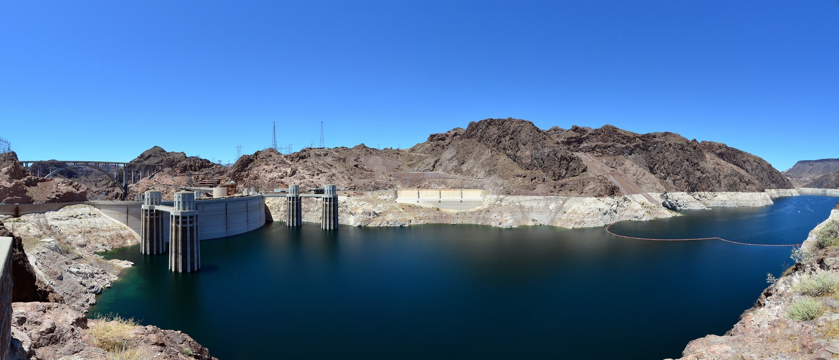
Jan 1st elevation | Arizona reduction | Nevada reduction | Mexico reduction
1075’ | 320,000 AF | 13,000 AF | 50,000 AF
1050’ | 400,000 AF | 17,000 AF | 70,000 AF
1025’ | 480,000 AF | 20,000 AF | 125,000 AF
No reductions to California
In Minute 319 & 323, Mexico agreed to voluntary reductions

Slide 14
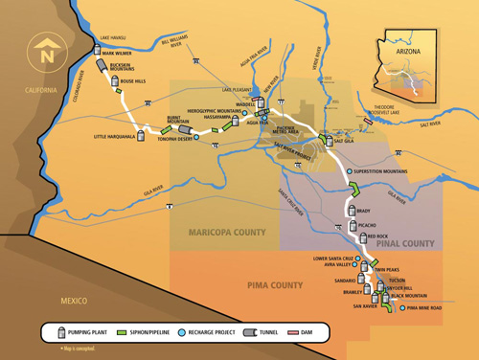
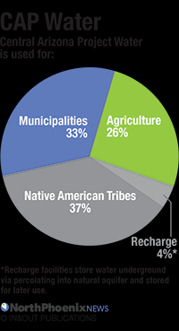
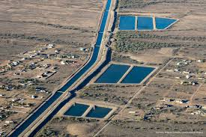
THE CENTRAL ARIZONA PROJECT AND
CENTRAL ARIZONA GROUNDWATER REPLENISHMENT DISTRICT

Slide 15
13

Slide 17
Using the Colorado River
Colorado River Use by Sector
Over 75% used by irrigated agriculture (about half for alfalfa)
Applied to 15% of U.S. farmland
Provides 90% of winter vegetables
Average Water Consumption in the Colorado River Basin (in approximate acre-feet per year)
Golf Courses: 138,000 af/y
Power Plants: 162,000 af/y
Alfalfa: 1.5 maf/y

Slide 18
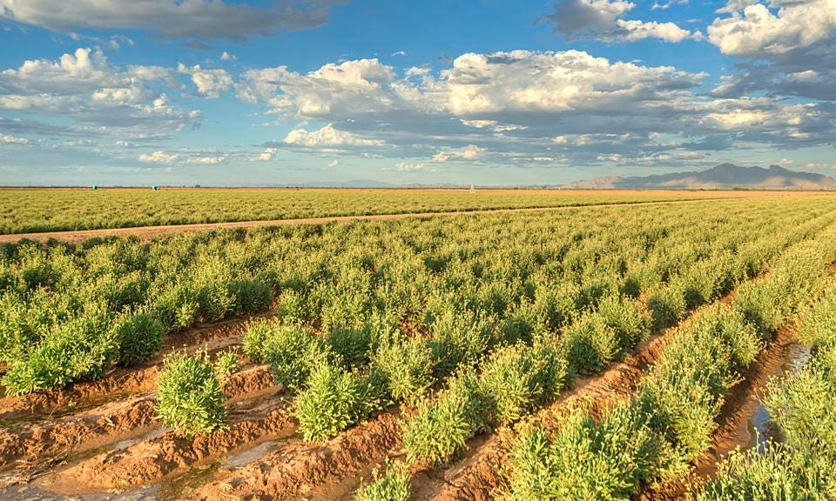
Future of Forage Crops
Benefits of Alfalfa
10-12 cuttings/year
Reasons for Alfalfa
Dairy & Beef
The Salt Problem
1 ton of salt/acre-foot
Risks to Alfalfa from Drought
Fallowing Incentives
Buy-and-Dry
Improved Irrigation Methods
Drip (what about salt and gophers?)

Slide 19
U.S.-Mexico Hydro-Diplomacy
1944 Rivers Treaty
1974 Salinity Control Act
All-American Canal Lining
Minute 319 & the Pulse Flow
Minute 323 Shortage Sharing
Minute 330 & Mexican Water Reserve
Mexican Farmers
IDE & WIFA Controversy
Compare to Jordan Basin
The Future of Desalination

Slide 20
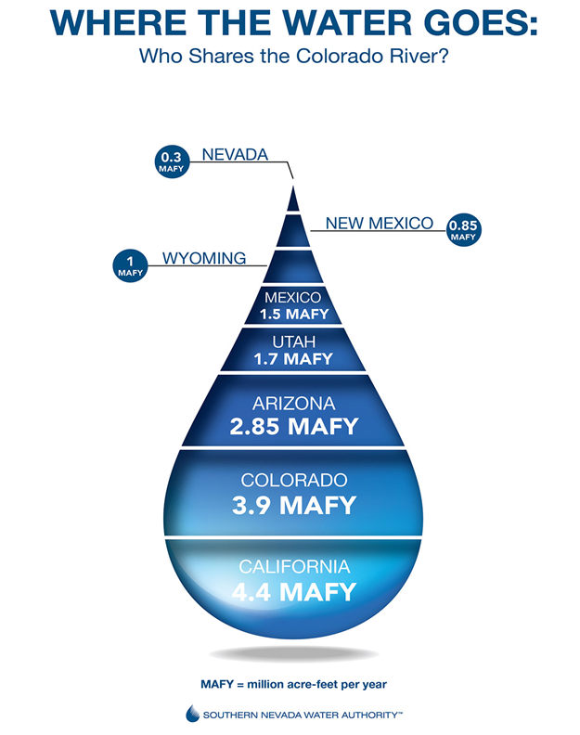
The Current Status of the Crisis
Shortage Sharing Guidelines & DCP all expire in 2026
The Perils of the DCP Negotiations
Role of Climate Change
Bureau of Reclamation says 2-4 maf/y needed to save the system
Risk of Deadpool
Tier 1 in 2020, Tier 2 in 2021-22, Back to Tier 1 in ’23-’24, likely to stay Tier 1 in 2025.
Status of Inter-State Negotiations
6 State Proposal – Account for Evapotranspiration
California Proposal – Abide by the Law of the River
Draft SEIS Options: Upper Basin Proposal vs Lower Basin Proposal
Better Hydrology + Federal Money = New Bargain to 2026
Tribal Water Rights
Hopi Quantification Trial
Colorado River Indian Tribes Water Marketing Bill
Gila River Indian Community & Intentionally-Created Surplus
Navajo Nation v. Arizona SCOTUS Decision
The Post-2026 World
Conservation & the Risk of Buy-and-Dry
Crop Shifts and/or Limitations on Growth
Off-Reservation Tribal Leases
Threats to Groundwater

Slide 21
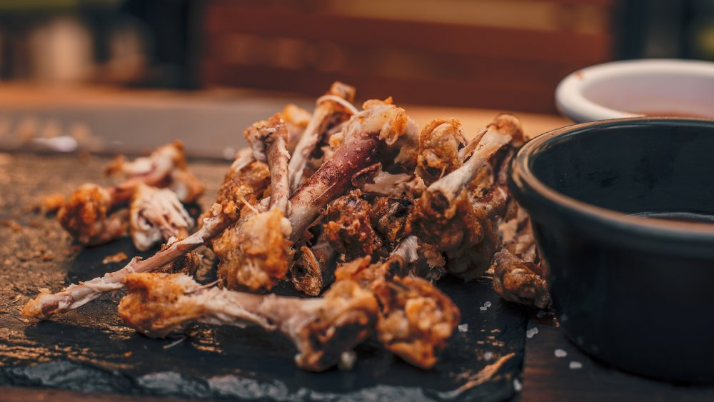
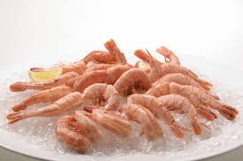
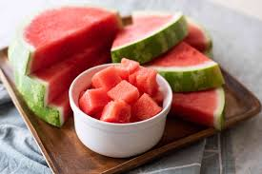
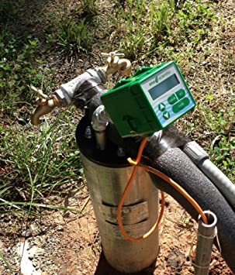

Slide 22
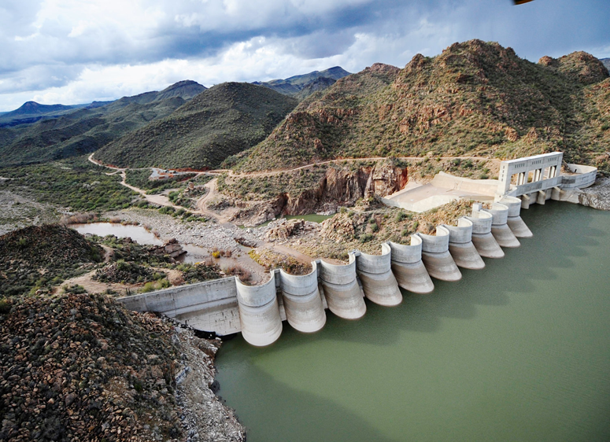
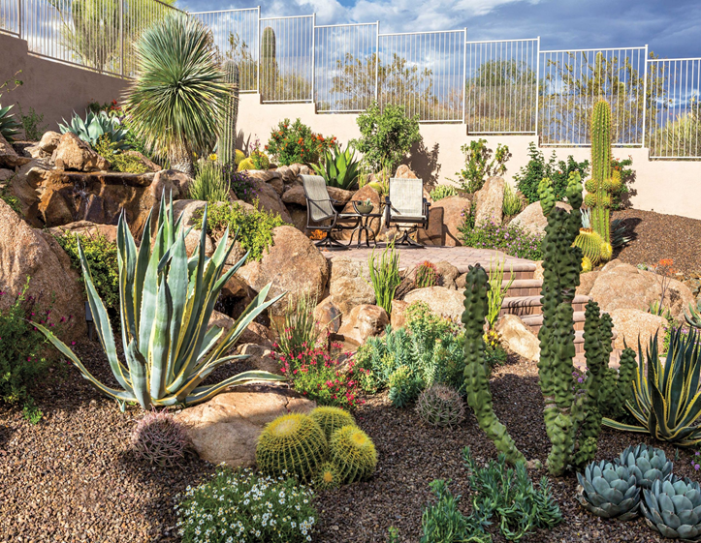
A Path Forward
Short-Term
BoR Gets Aggressive & Litigation
Evapotranspiration for Salton Sea
Funding ICS
IID & WMID Savings
Risks of Buy-and-Dry
CRIT Off-Rez Lease
Full-Time Water Courts
Incentives for Desert-Scape
WIFA Conservation
Better Data – GRACE Satellite
Navajo/Hopi/San Juan Paiute Settlement
Medium-Term
Yavapai Apache Settlement
Direct Potable Reuse
Harquahala Imports
Expand Bartlett Dam
Rural Groundwater Management
Industrial & Data Cooling Technology
Long-Term
Desalination?
East-West Pipeline or Exchange
Agave, Barley, & Guayule
Forestry Management Incentives
Financing Conservation (Biosynthetic Membranes)
Remove Glen Canyon Dam?
Toward a More Adaptive Regime
Conserve for what?
What do we want to be when we grow up?

